Slide 1




Spam Detection Using Machine Learning.
supervised by Dr:shimaa musaad Eng:Yasmine
1

Slide 2

Agenda
Introduction.
Related Of Spam Detectors.
Algorithms.
Data set .
spam, ham classifier work flow.
The steps we have taken.
Home page of application.
Demo.
2

Slide 3










Our Team Members
Team Leader Name
Team Member Name
Ahmed Tarek Abdelfath
Id(20-02018)
Ahmed Abdelnasser maria
Id(20-01730)
Team Member Name
Team Member Name
Nourhan Ahmed Mohamed
Id(20-00456)
selvia Emad Sobhy
Id(20-01836)
Team Member Name
Team Member Name
Ahmed Ibrahim Abdellatif
Id(20-00408)
Mostafa Mohamed Mounes
Id(20-00558)
Team Member Name
Team Member Name
Ahmed Mahmoud Abdelsamea
Id( 20-00400)
Mohamed Ayman Abass
Id(20-01848)
3

Slide 4
Introduction
In today's globalized world, email is a primary source of communication. This communication can vary from personal, business, corporate to government.
With the rapid increase in email usage, there has also been increase in the SPAM emails. SPAM emails, also known as junk email involves nearly identical messages sent to numerous recipients by email. Apart from being annoying, spam emails can also pose a security threat to computer system.
It is estimated that spam cost businesses on the order of $100 billion in 2007.
4
Symantec. (2007). The State of Spam: A Monthly Report - August 2007. Retrieved from http:// www.symantec.com/avcenter/reference/symantec_Spam_Report_-_August_2007.pdf.

Slide 5
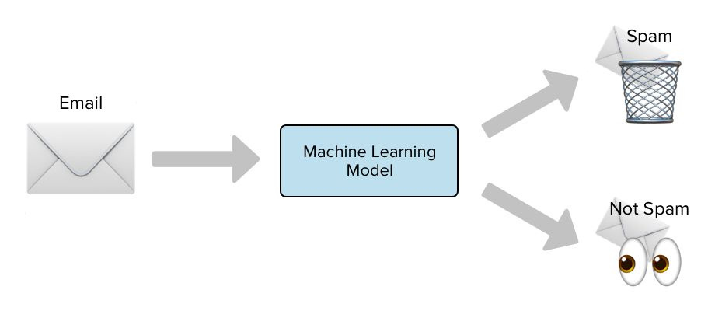
Introduction
In this project, we use text mining to perform automatic spam filtering to use emails effectively.
We try to identify patterns using
Data-mining
classification algorithms
such as (SVM, Random forest) to enable us classify the emails as HAM or spam.
5

Slide 6
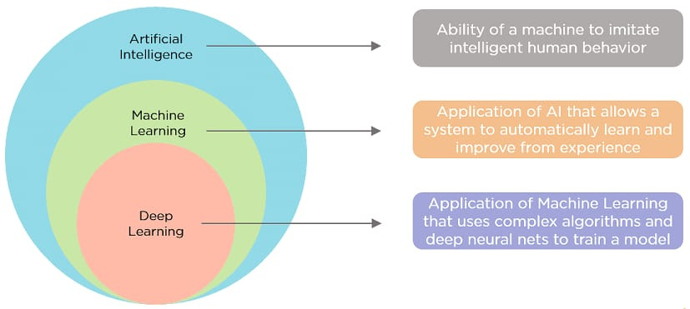
machhine learning
6

Slide 7
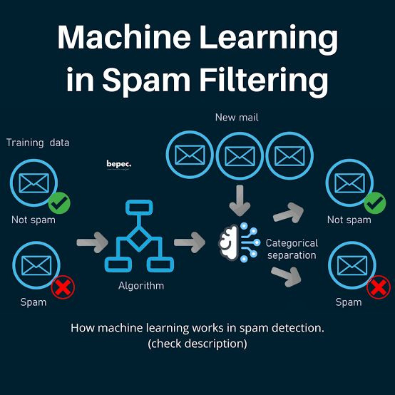
Leverage Machine Learning For Filtering Messages..
7

Slide 8
Some Examples Of Spam Detectors:
N-Able Mail Assure: It collects and analyzes data from over 2.5 million mailboxes to identify and predict new outbreaks.
Cisco Email Security: security solution that provides advanced threat protection, spam filtering, and data loss prevention for email communications.
Symantec Email Security: Symantec provides advanced email security solutions that include spam filtering, threat detection, and email encryption to protect against spam and other email-based threats.
Spam Bayes: This is a spam filter that uses a statistical approach based on Bayesian inference to classify messages as spam or ham (non-spam)
8

Slide 9
2.Random forest
•Random forest, a popular machine learning algorithm, merges the outputs of numerous decision trees to produce a single outcome.
•developed by Leo Breiman and Adele Cutler.
• Its popularity stems from its user-friendliness and versatility, making it suitable for both classification and regression tasks.
Advantages:
•It performs well even if the data contains null/missing values.
•Each decision tree created is independent of the other; thus, it shows the property of parallelization.
•It solves the problem of overfitting as output is based on majority voting or averaging.
Disadvantages:
•Random forest is highly complex compared to decision trees, where decisions can be made by following the path of the tree.
•Training time is more than other models due to its complexity. Whenever it has to make a prediction, each decision tree has to generate output for the given input data.
9

Slide 10
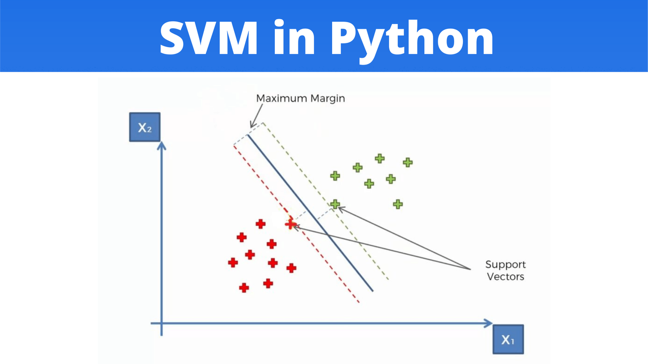
Algorithms
Support vector machines.
SVMs were laid by Vladimir Vapnik and Alexey Chervonenkis in the 1960s.
SVMs are a class of supervised learning algorithms used for both classification and regression tasks.
SVMs gained widespread popularity in the 1990s, largely due to the work of Corinna Cortes and Vladimir Vapnik.
Advantages:
1.Effective in high-dimensional spaces.
2.Robust to overfitting, especially in high-dimensional space.
3.Works well with clear margin of separation
Disadvantages:
1.Choosing the right kernel can be complex.
10

Slide 11


Time
Accuracy
SVM
Random forest
4hours taking in training model.
66 minutes taking to training model.
Accuracy:0.9823
Accuracy:0.98109
11

Slide 12


12

Slide 13

Data set
A machine learning dataset is a collection of data that is used to train the model. A dataset acts as an example to teach the machine learning algorithm how to make predictions dataset as "a collection of data that is treated as a single unit by a computer". This means
With the goal of finding predictable pattern inside the whole data set.
13

Slide 14

some data set we search for it
1.we use190k+ Spam | Ham Email Dataset for Classification
2.Ling-spam dataset
3.Spam text messages dataset
4.Spam assassin
why use 190k+Spam | Ham Email Dataset for Classification.csv
Because the project needs big dataset, and its the biggest one
14

Slide 15
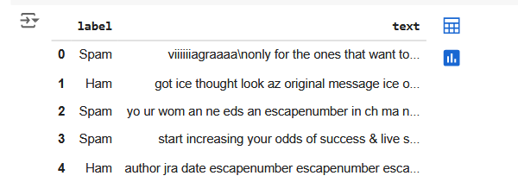
Description of Data set
Spam email percentage in the dataset =47%
Ham email percentage in the dataset =53%
The dataset consist of 193849 text message from UCI Machine learning repository.
15

Slide 16
16

Slide 17
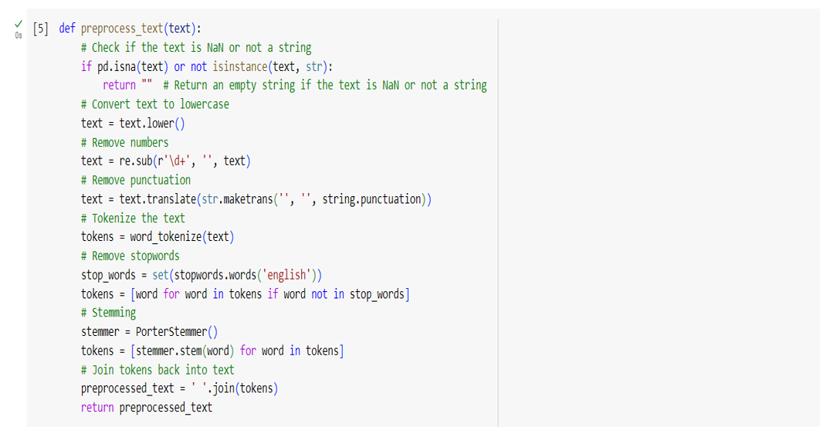
17

Slide 18
18

Slide 19
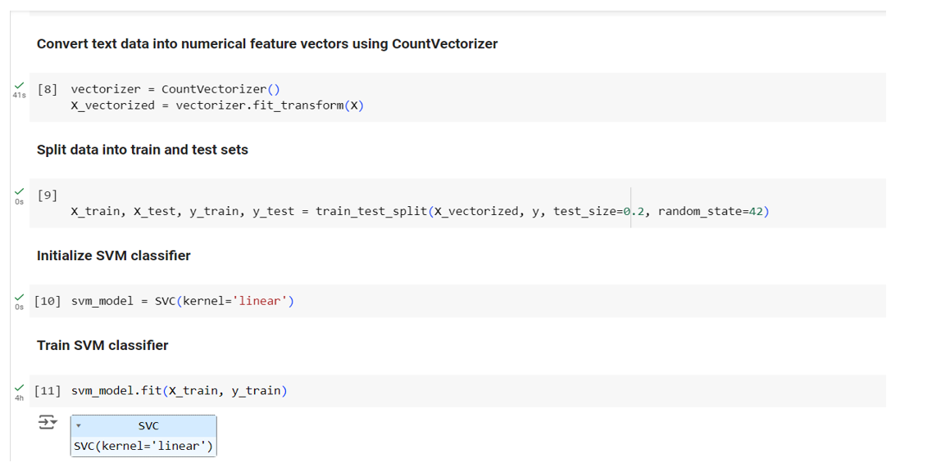
19

Slide 20
20

Slide 21
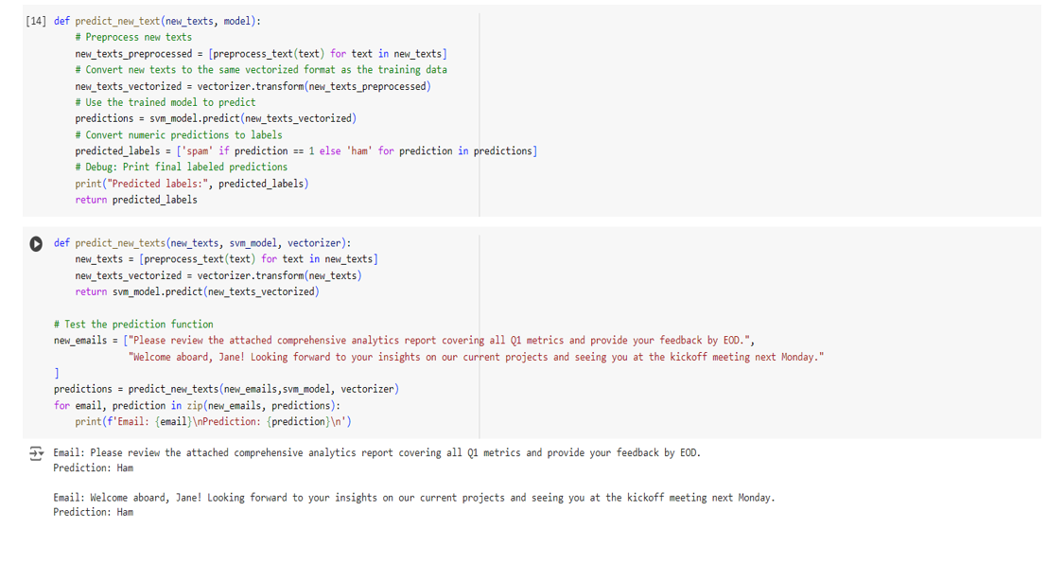
21

Slide 22
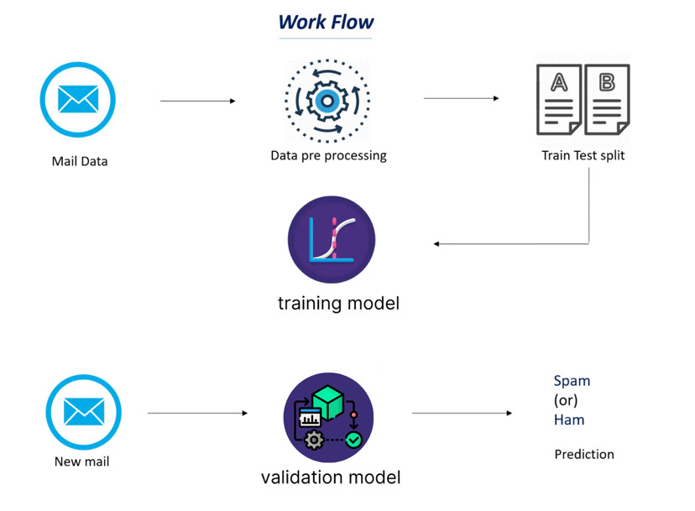
spam, ham classifier work flow
22

Slide 23
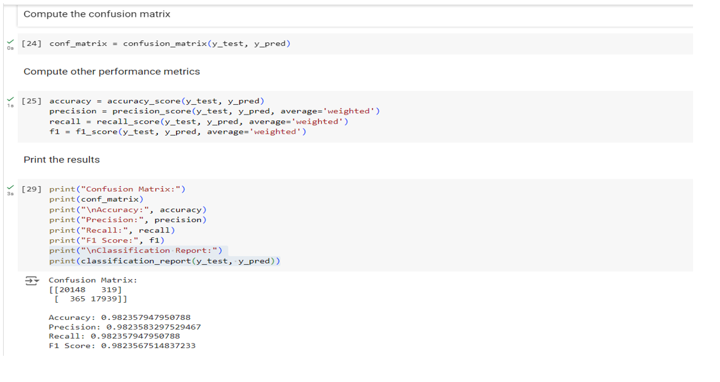
Accuracy
23

Slide 24
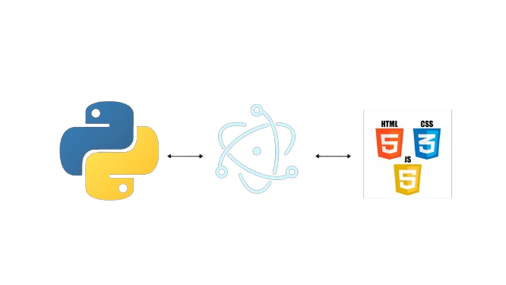
Technologies
Technologies used:-
Python
HTML
css
libraries:-
scikit-learn
numpy
scipy
upgrade
asgiref
tzdata
joblib
sklearn
nltk
24

Slide 25
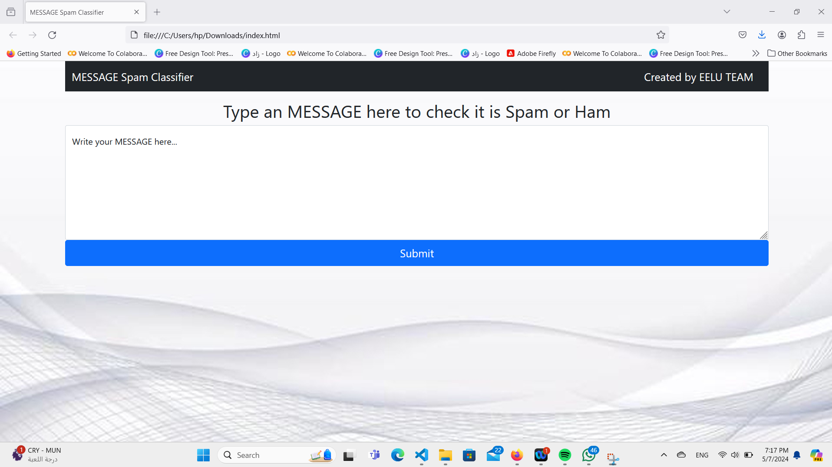
Home of application
25

Slide 26
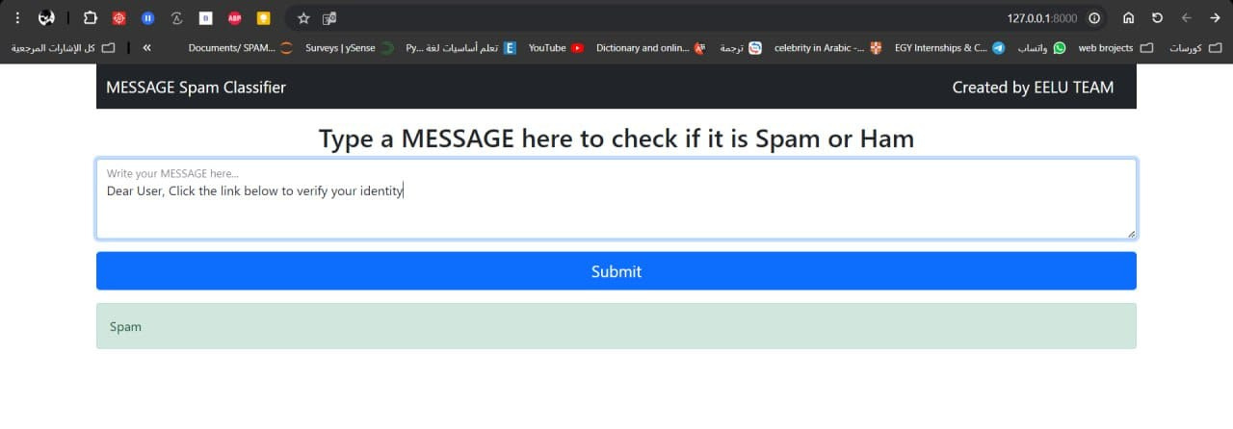
detection spam messages
26

Slide 27
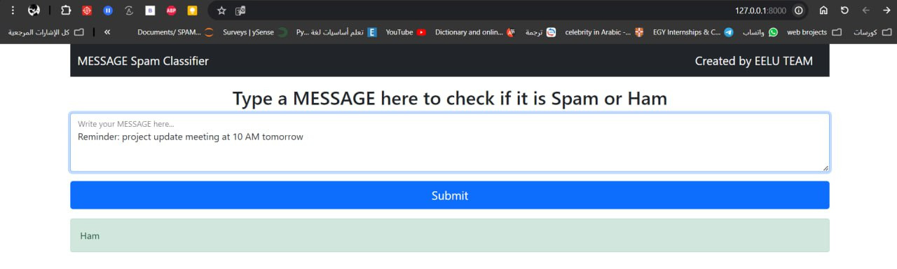
detection Ham messages
27

Slide 28
finally this is
demo
28

Slide 29
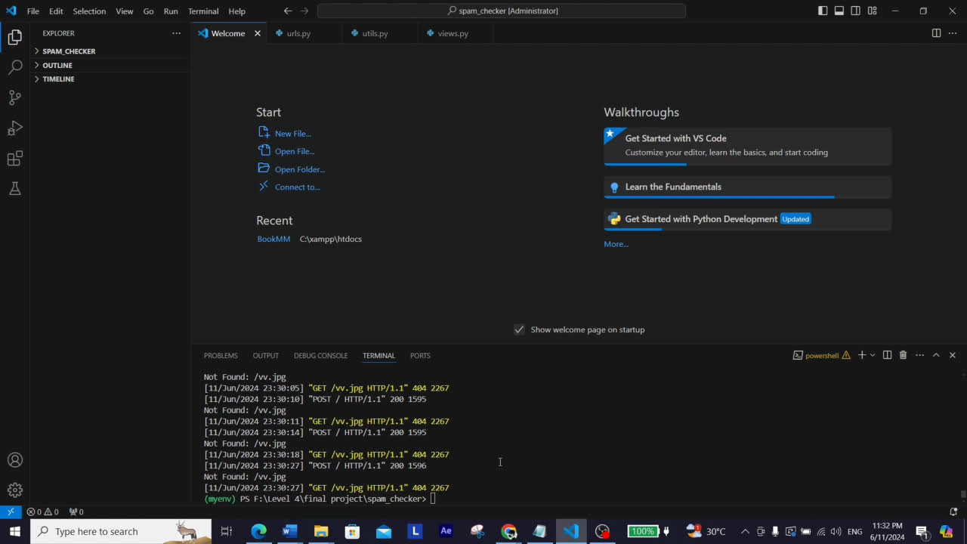
29

